Slide 1
TeamSix
Enterprise Web Software
Member:
Pham The Phi
Hoang Khanh Son
Pham Tuan Kiet
Trinh Huynh Duc
Tong Dam Thang Long
Nguyen Thanh Nhan

Slide 2
Table of Content
Product Backlog
Sprint Backlog
Wireframe
UseCase
Class Diagram
Sequence Diagram
ERD
Interface
Quality Evaluation

Slide 3
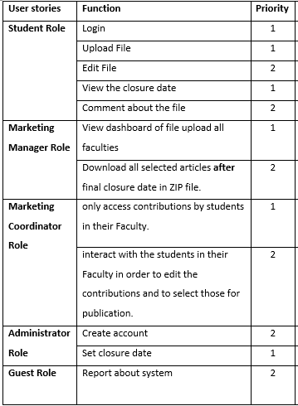
Product Backlog

Slide 4
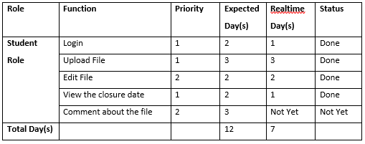
Sprint Backlog 1

Slide 5
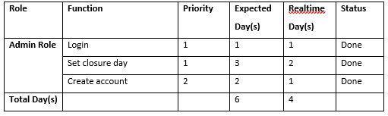
Sprint Backlog 2

Slide 6
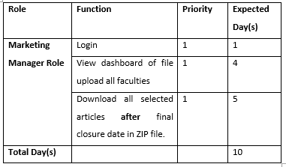
Sprint Backlog 3

Slide 7
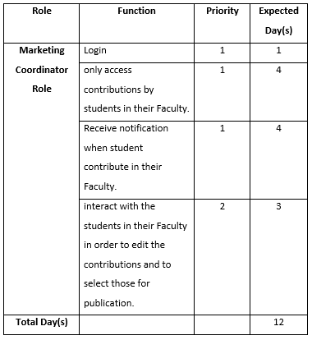
Sprint Backlog 4

Slide 8
Wireframe (Student)

Slide 9
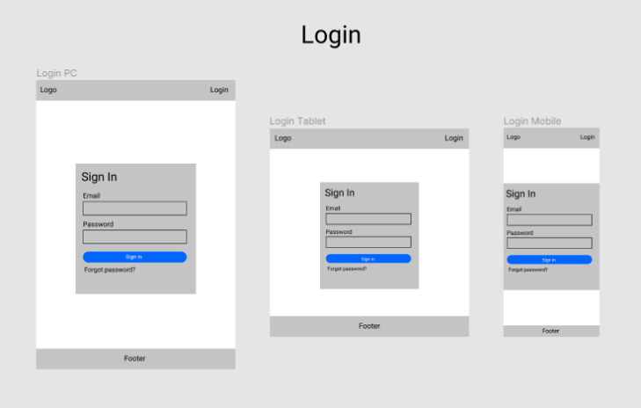
Login

Slide 10
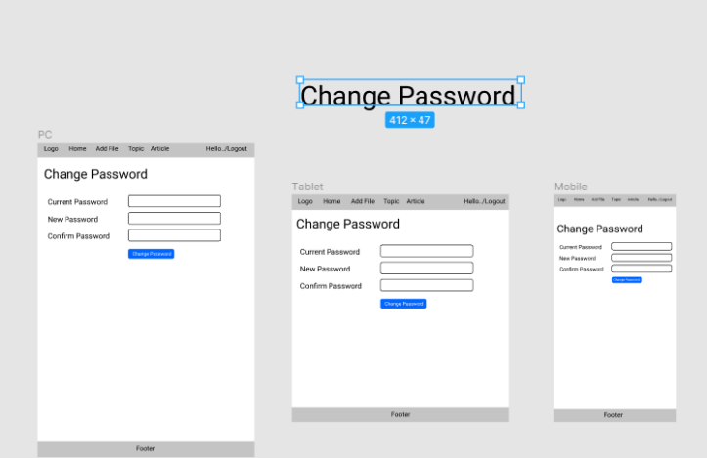
Change Password

Slide 11
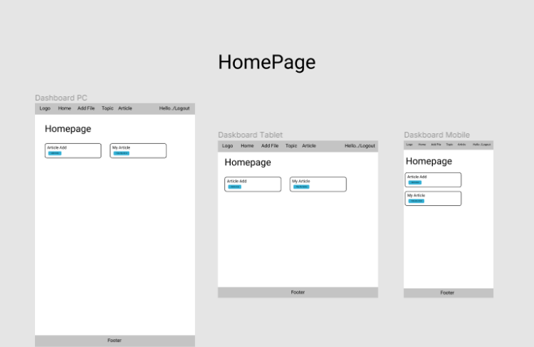
Homepage

Slide 12
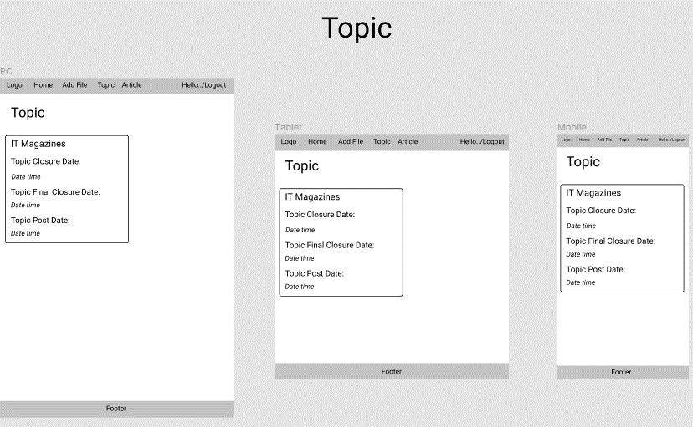
Topic

Slide 13
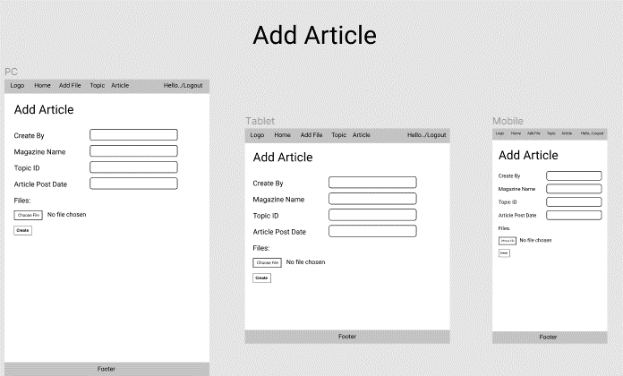
Add Article

Slide 14
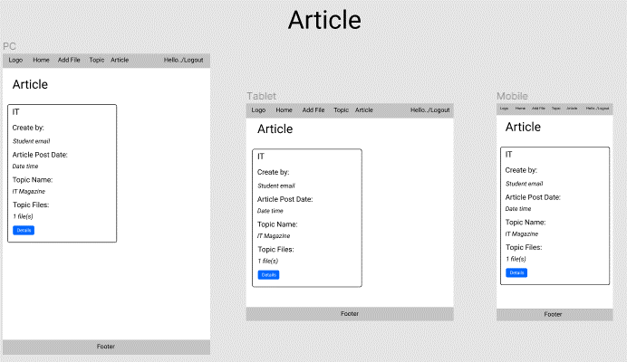
Article

Slide 15
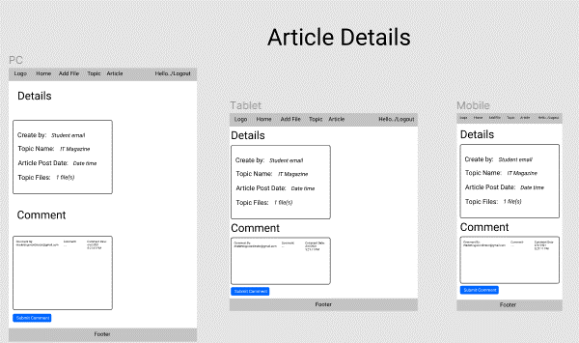
Article Detail

Slide 16
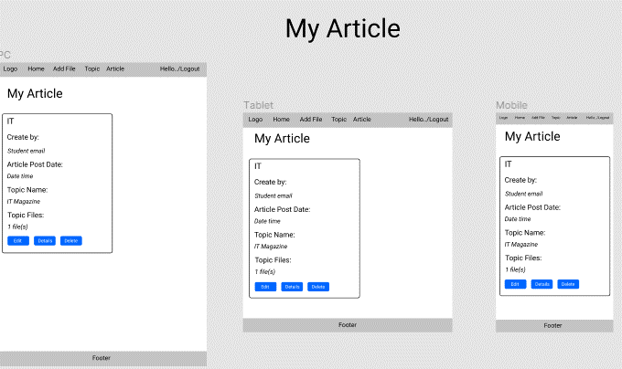
My Article

Slide 17
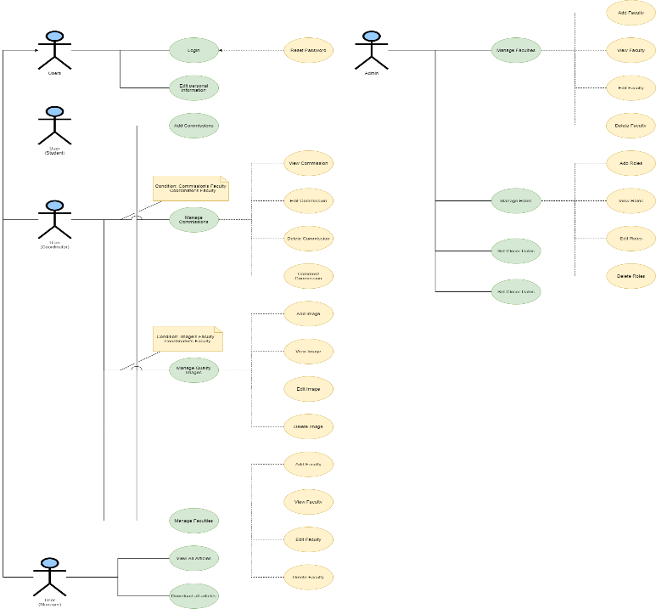
UseCase

Slide 18
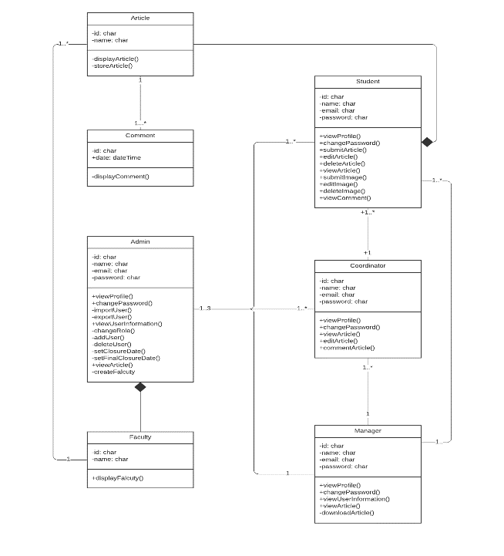
Class Diagram

Slide 19
Sequence Diagram

Slide 20
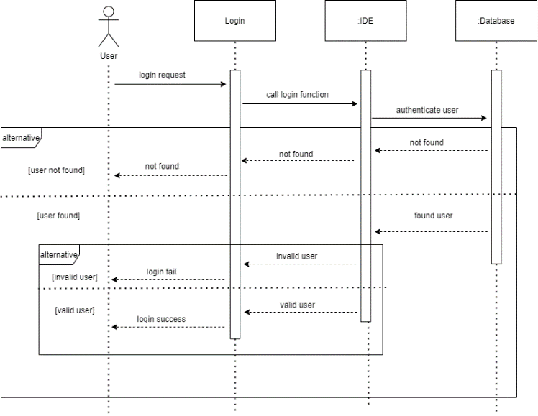
Login

Slide 21
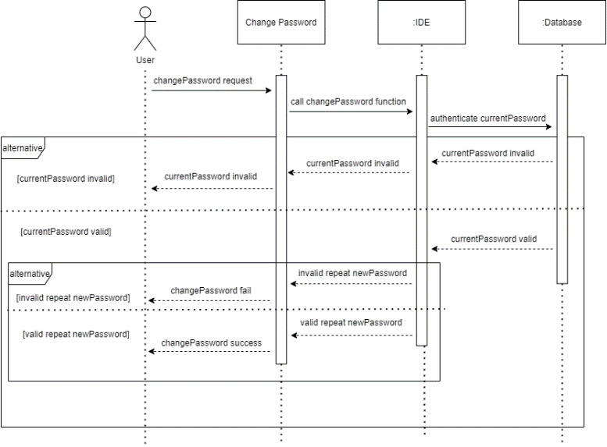
Change Password

Slide 22
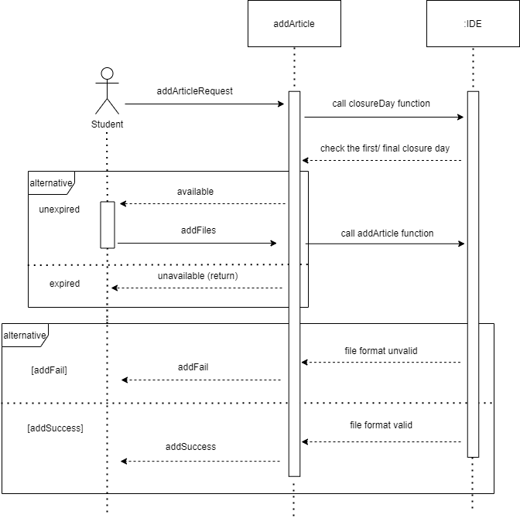
Student Add Article

Slide 23
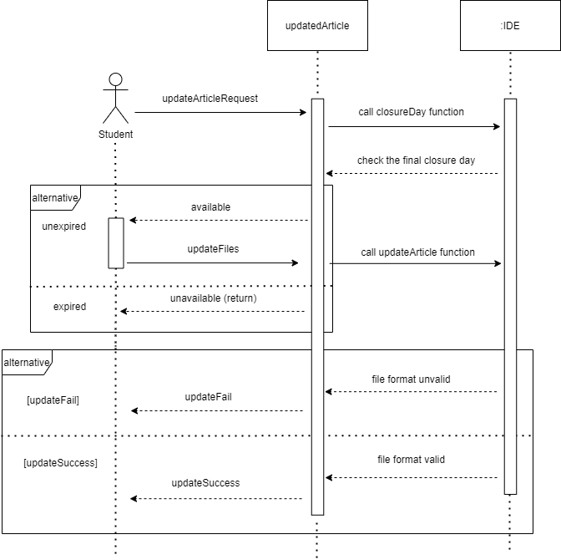
Student Update Article

Slide 24
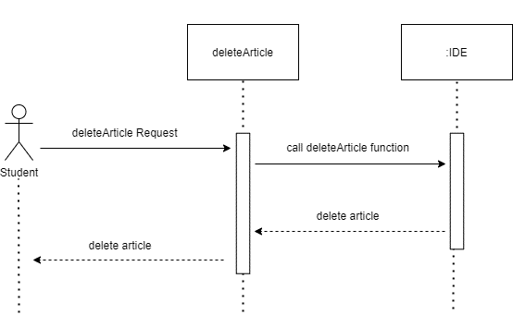
Student Delete Article
This Sequence Diagram describes the delete function and is similar to the sequence diagram of the create, and edit functions. Roles that have these functions all have the way they behave as shown below.

Slide 25
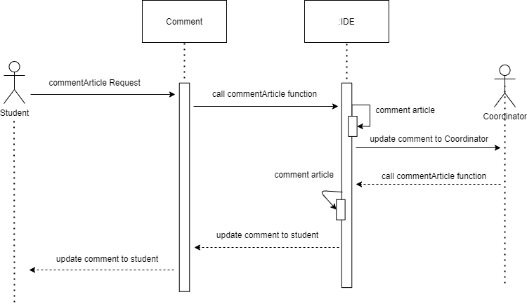
Comment

Slide 26
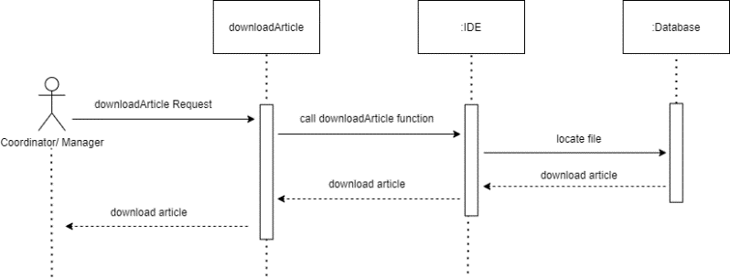
Download Article

Slide 27
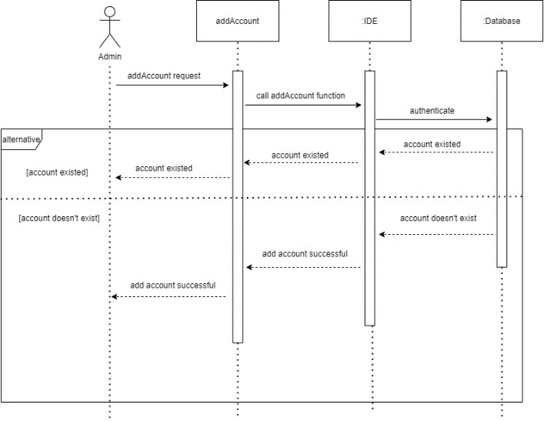
Add Account

Slide 28
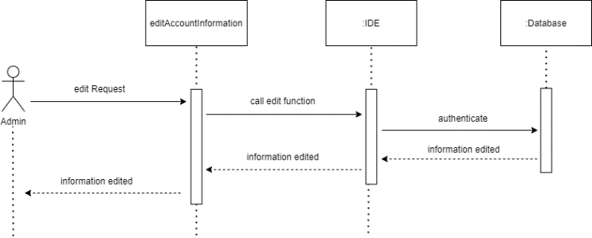
Edit Account

Slide 29
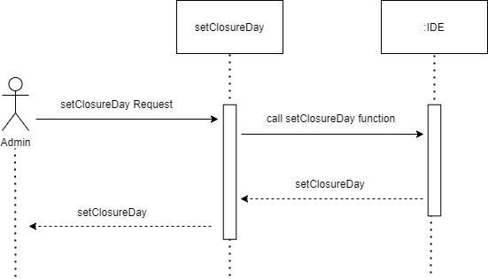
Set Closure Day

Slide 30
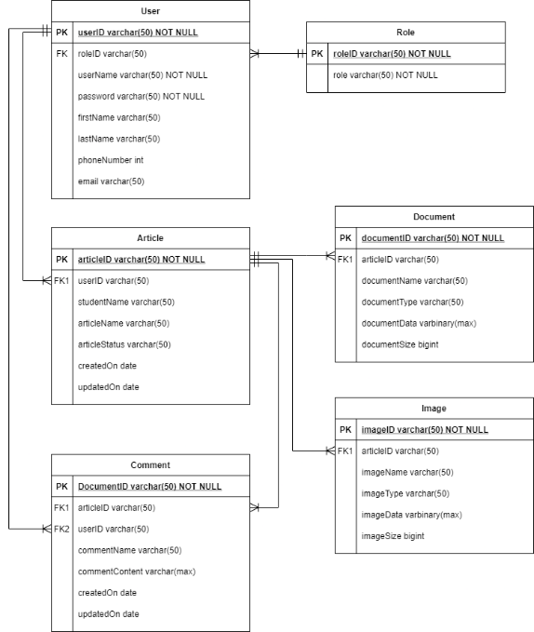
ERD

Slide 31
Interface

Slide 32
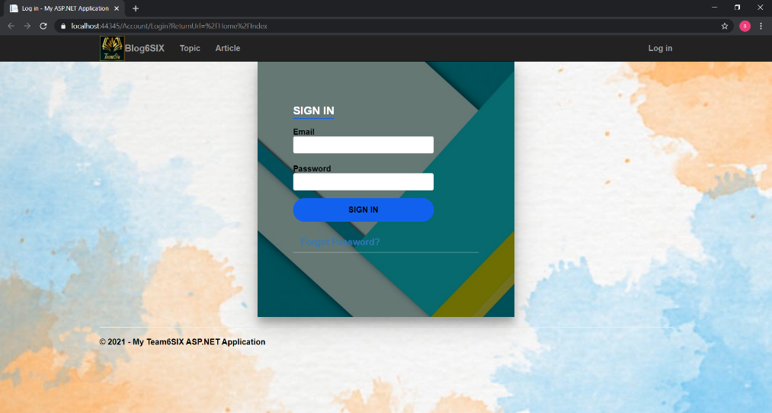
Login Page

Slide 33
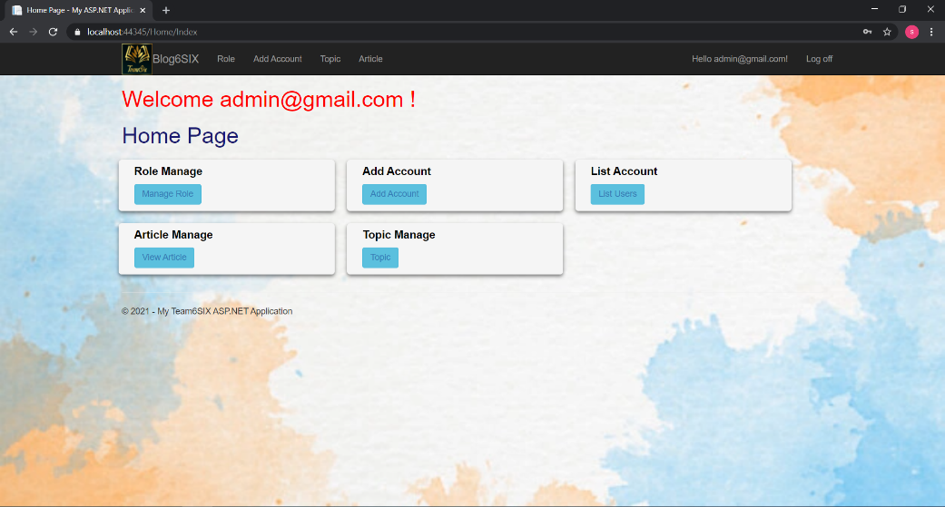
Admin Page

Slide 34
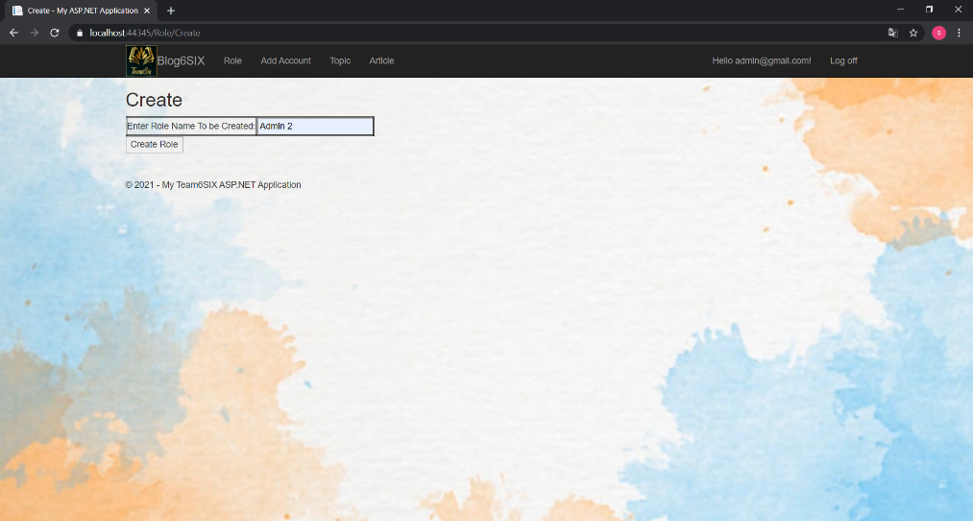
Create Role( Admin function)

Slide 35
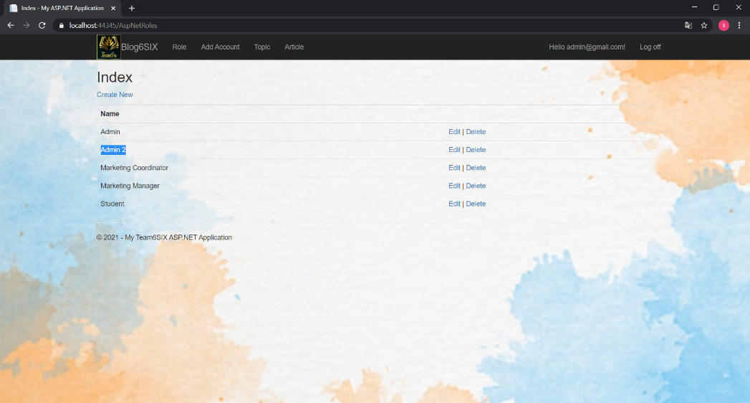
View List Role

Slide 36
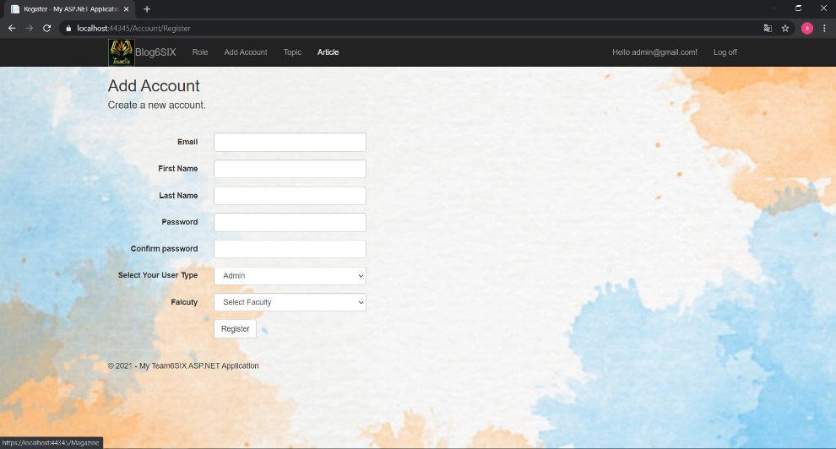
Create Account

Slide 37
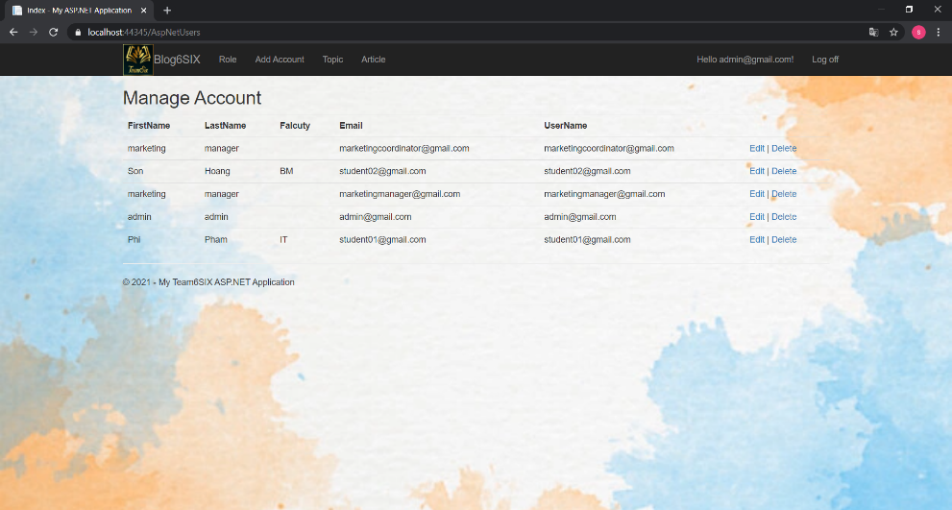
Manage List Account

Slide 38
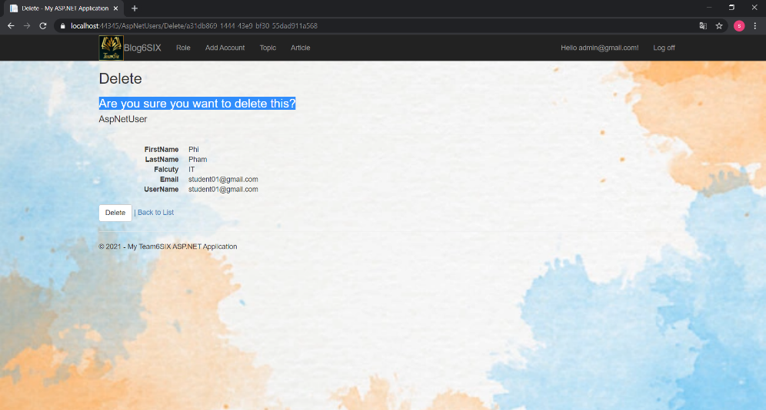
Delete Account (confirm step)

Slide 39
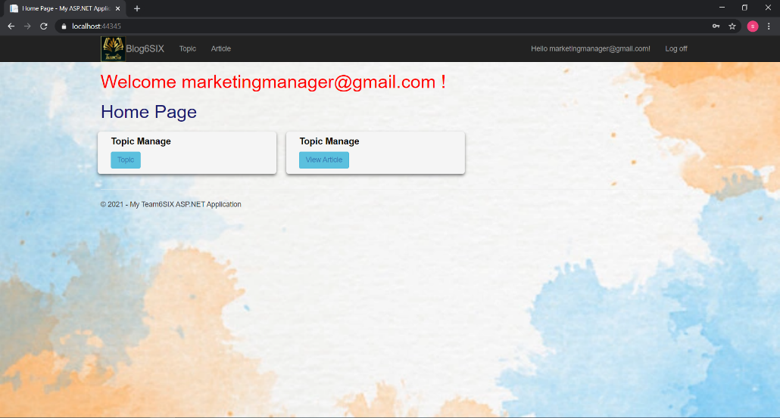
Marketing Manager Page

Slide 40
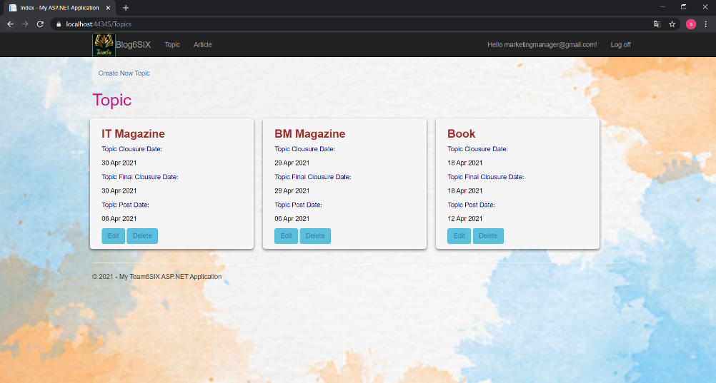
Manager can view and edit Topic

Slide 41
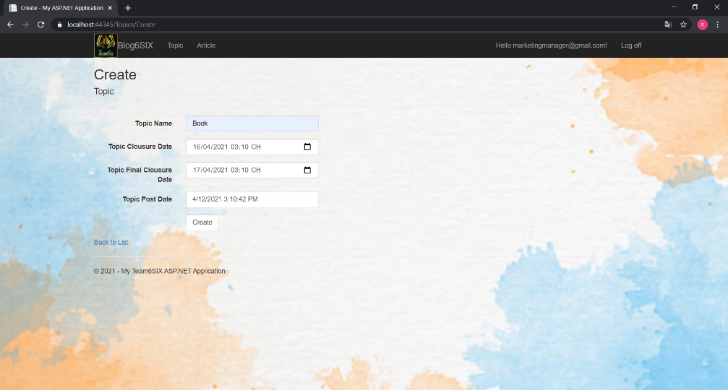
Create Topic

Slide 42
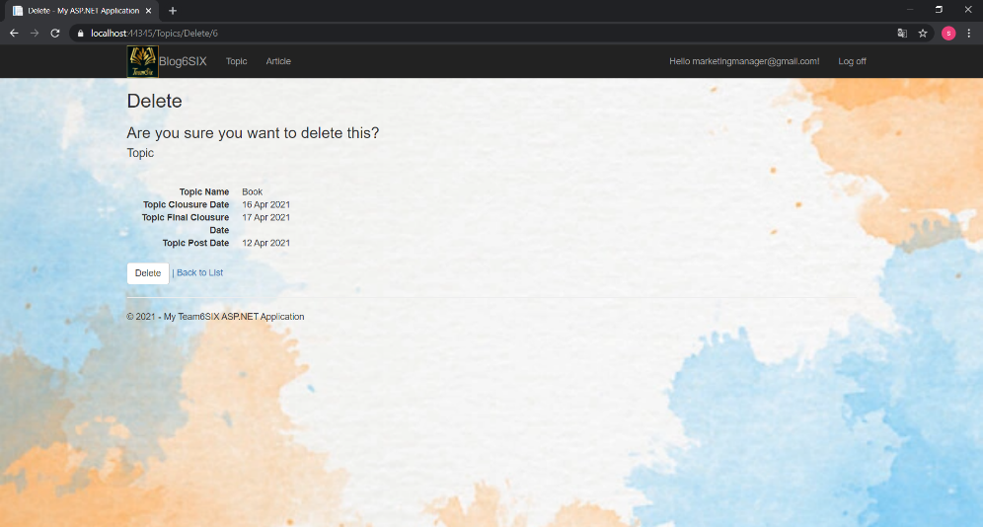
Delete Topic

Slide 43
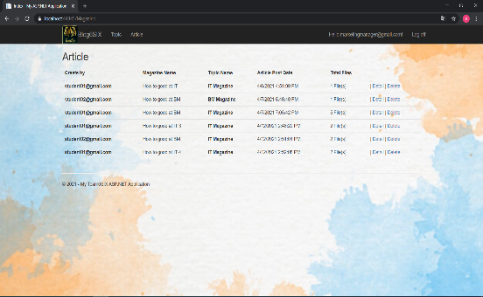
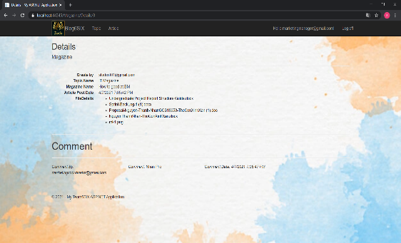
View the number of documents submitted by students and can download them in FileDetails

Slide 44
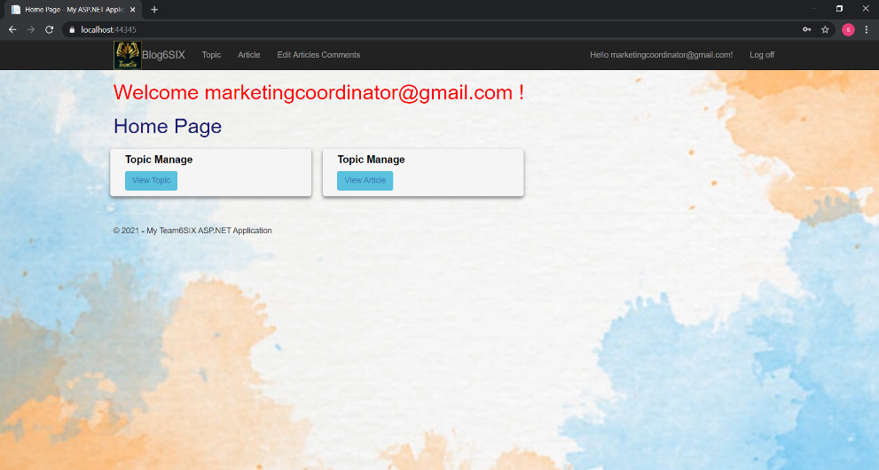
Marketing Coordinator Page

Slide 45
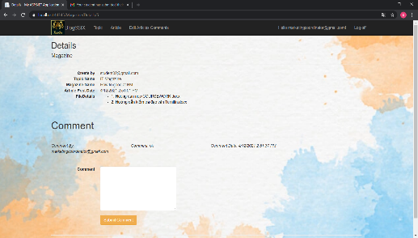
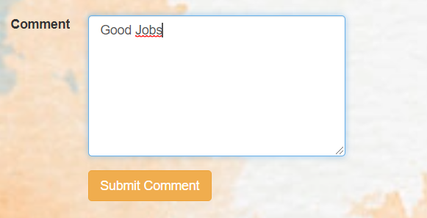
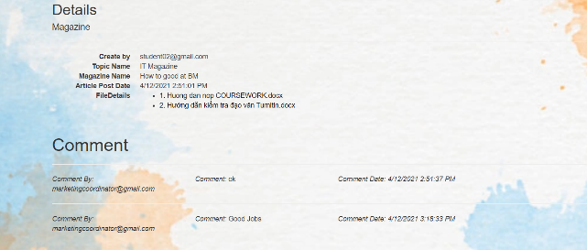
Marketing Coordinator Comment in Topic

Slide 46
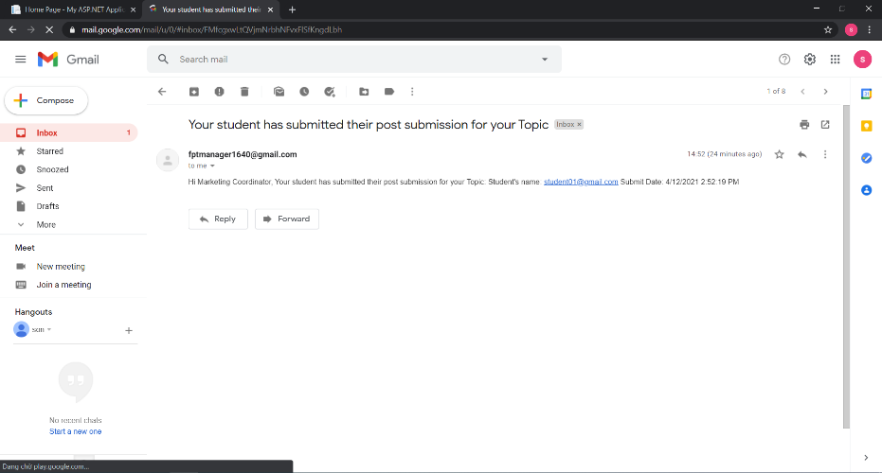
Receive alert in email when student submit their Topic

Slide 47
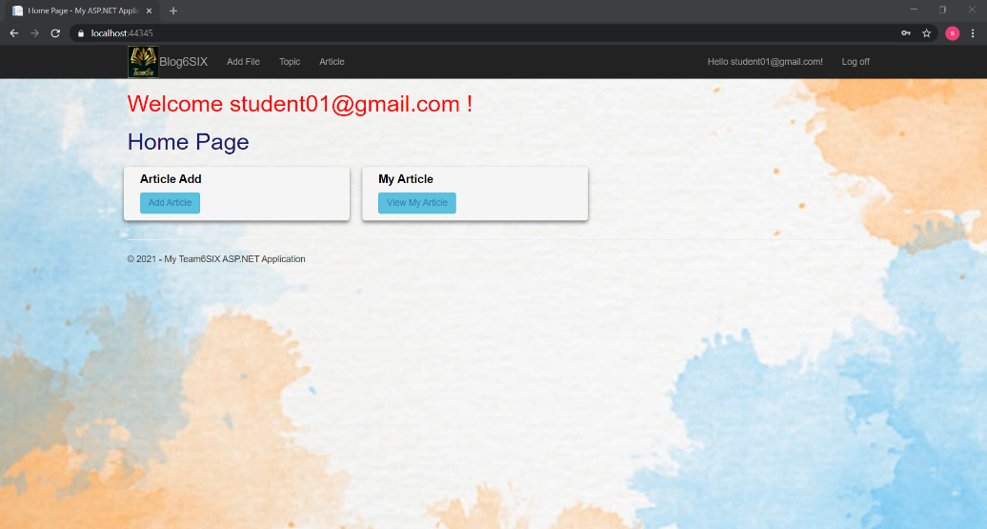
Student Page

Slide 48
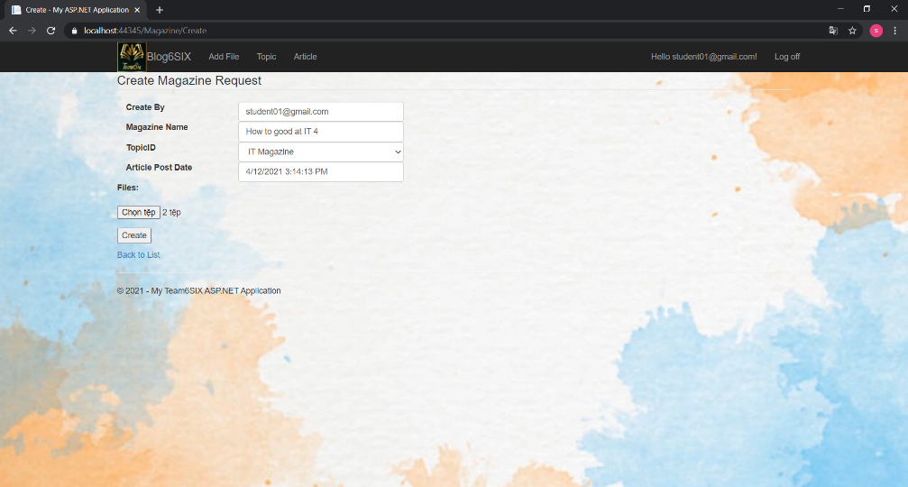
Add Article

Slide 49
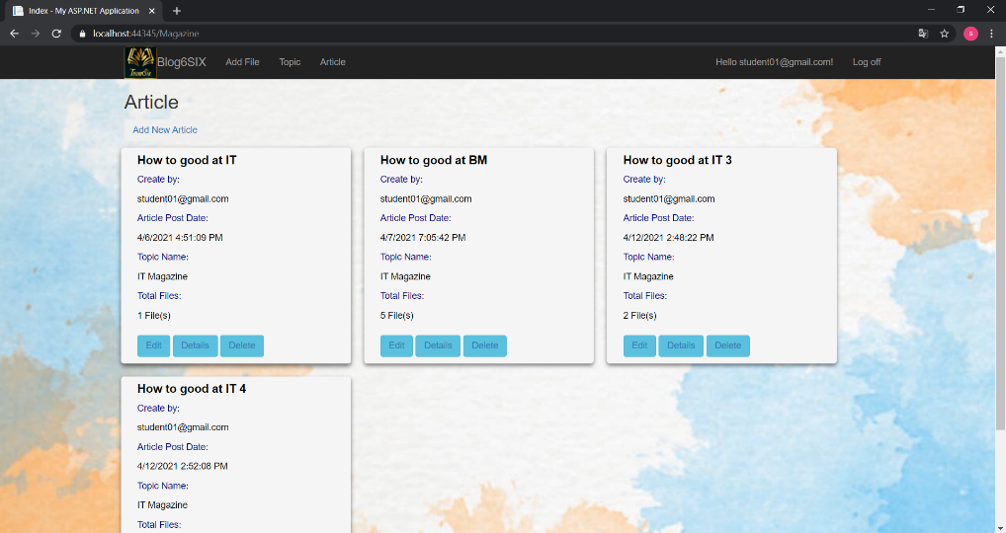
View Article Submitted

Slide 50
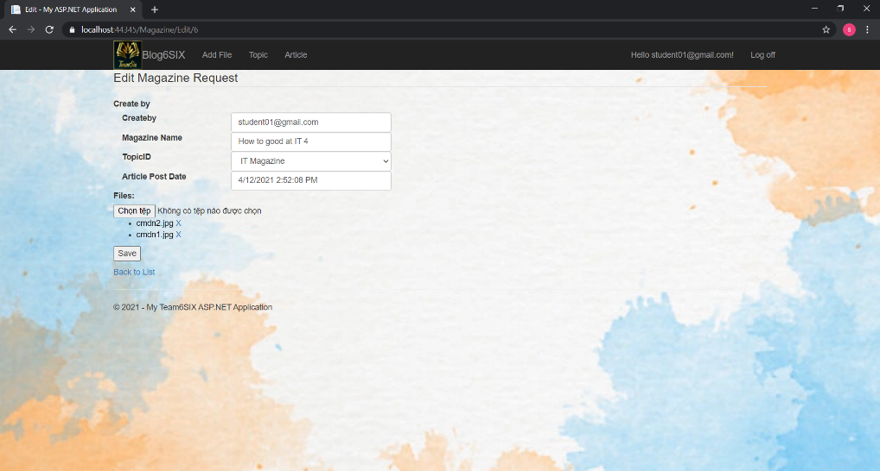
Edit Article

Slide 51
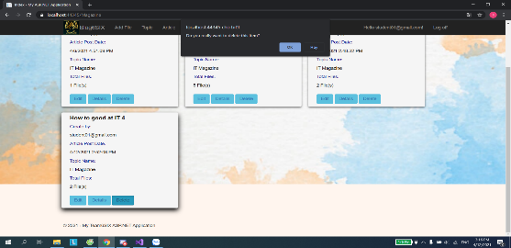
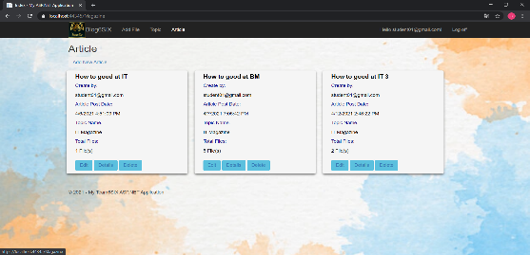
Delete Article

Slide 52

View Topic

Slide 53

Quality Evaluation (Test Case)

Slide 54
Overall evaluation Test Case
Overall evaluation of the quality testing of the system's functions through typical test cases is: Login is the best case when there is no Actual result "fail", all of them "pass". Particularly the remaining typical functions such as the Admin role have functions whose Actual result is still incomplete, such as “Test if admin can set the closure date before today”, and “Test if student can upload articles after the closure date ”.
Next, the functions in the Student role almost all Actual results pass, but there are two functions that have not been successfully completed by the group: "Test if Student can see their profiles", and "Test if Student agree to Terms. and Conditions before submitting ”.
In the Marketing Coordinator role, after testing a total of 5 functions, only one failed function is "Test if Marketing Coordinator can select student's articles in their faculties to publish". Finally, the Marketing Manager role has a total of 2/4 incomplete fail functions, namely “Test if Marketing Manager can see the Dashboards”, and a function “Test if Marketing Manager can download the articles into a .zip file”. The percentage number between successful and fail is 80% success and 20% fail.

Slide 55
Thank for Listening!

